Slide 1









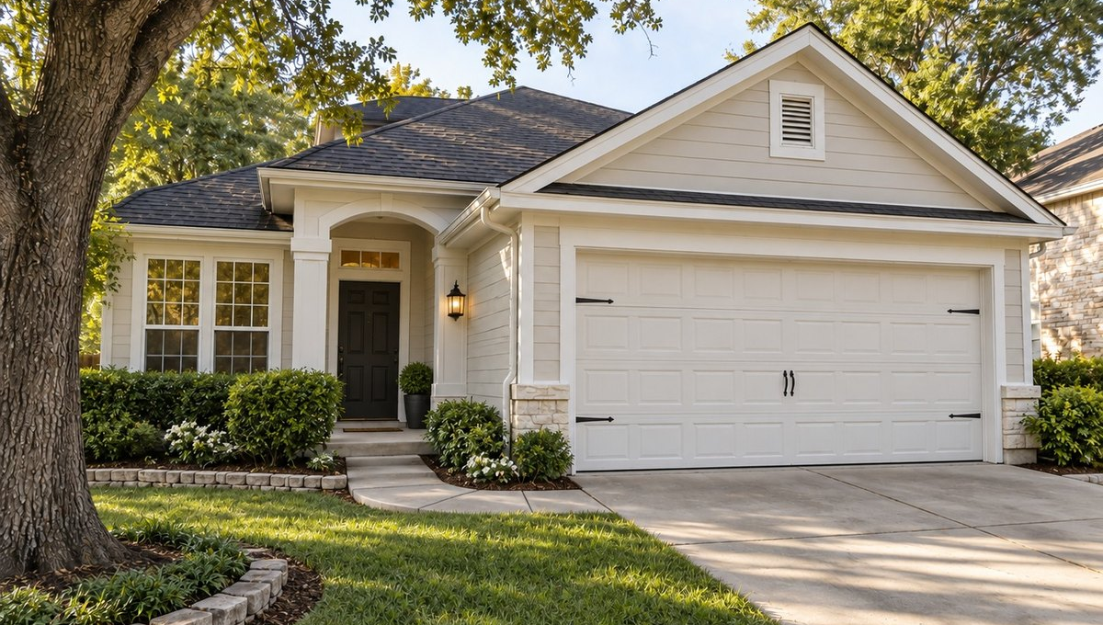
OWNER-LED / AUSTIN-BUILT
A HIGHER STANDARD FOR EVERY SPACE.
Property services. Done properly.
Painting
Landscaping
Property work
Interiors and exteriors.
Outdoor spaces.
Residential and commercial.
WHY COSMIC
Clear communication
Boots on the ground
On time delivery
Care for your space
Updates, realistic timelines and quick responses. No surprises.
Owner-led. We're on site and we see it through.
Projects get finished when we say they will be.
We leave it better, with respect for places people live and work.
500+
Spaces improved
98%
On-time completion
5.0
Average rating
CASE STUDY / ZILKER
FULL EXTERIOR REPAINT.
2,850 sq ft. 6 working days. 4 crew.
GET A CLEAR ESTIMATE.
(512) 348-6433
(512) 348-6232
choosecosmic.com
Notes:
print/07-flyer-front

Slide 2

[TBC: DATE]
Dear ,
[TBC: NAME]
WE HAVE A NEW NAME AND A NEW LOOK.
Our name is now Cosmic, and we wanted you to hear it from us first.
Same crew. Same standard of work. A new look, and a higher standard for every space.
Four things guide every job we take on:
CLARITY
No surprises.
CRAFT
Do it properly.
CARE
Leave it better.
COMMIT
See it through.
Nothing about how we work has changed. You will still know what is happening, and we will still see every job through. Thank you for trusting us with your places. Whether it is a first estimate or the next project, we would be glad to hear from you.
Roberto Martínez
Carlos R. Estrada
CO-FOUNDER
CO-FOUNDER
P.S. Good work should keep working for you. If you know someone who would like it done properly, tell them about The Club.
choosecosmic.com
(512) 348-6433 · (512) 348-6232
2301 W Anderson Ln , Austin, TX 78757
[TBC: SUITE]
Notes:
print/10-letter-rebrand

Slide 3
2301 W Anderson Ln
[TBC: SUITE]
Austin, TX 78757
(512) 348-6433
(512) 348-6232
choosecosmic.com
Property services. Done properly.
Owner-led / Austin-built
Notes:
print/12-letterhead

